Slide 1
Scaffold analytics figures to modify with chemical structures
Deepak Bandyopadhyay
Rajarshi Guha
Constantine Kreatsoulas

Slide 2
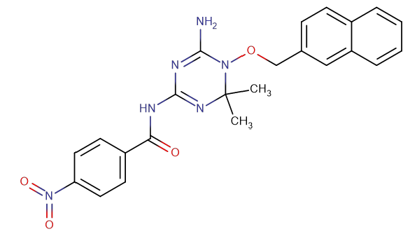
Fig2a

Slide 3
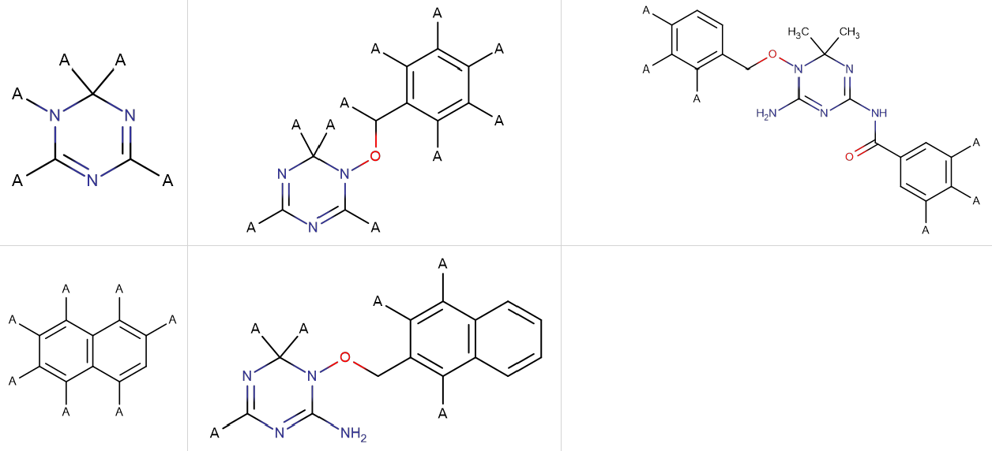
Fig 2b

Slide 4
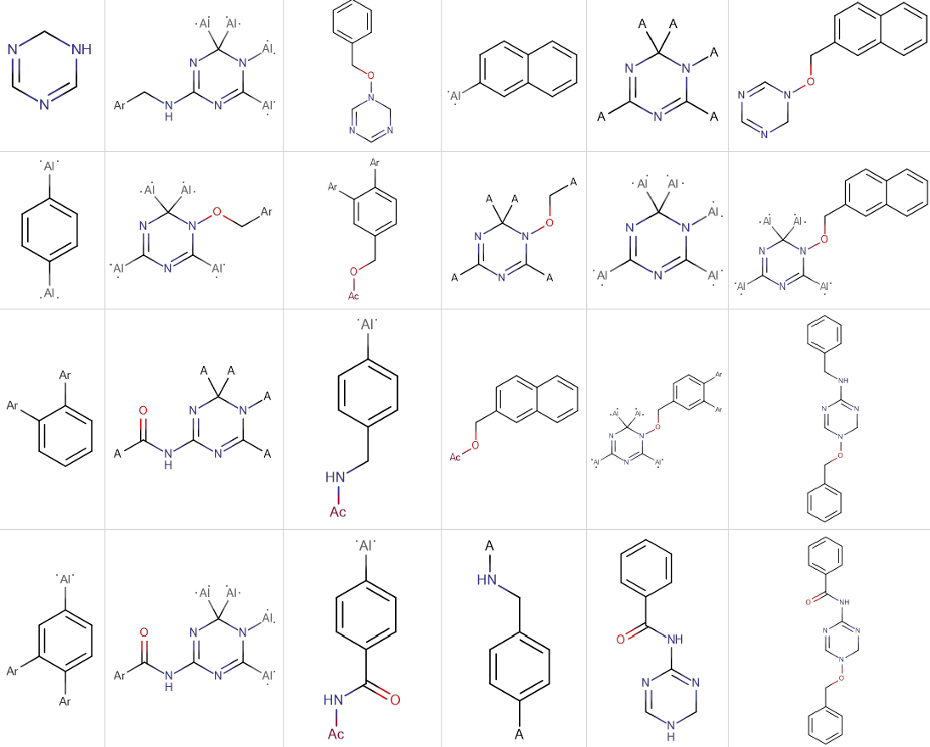
Fig 2c

Slide 5
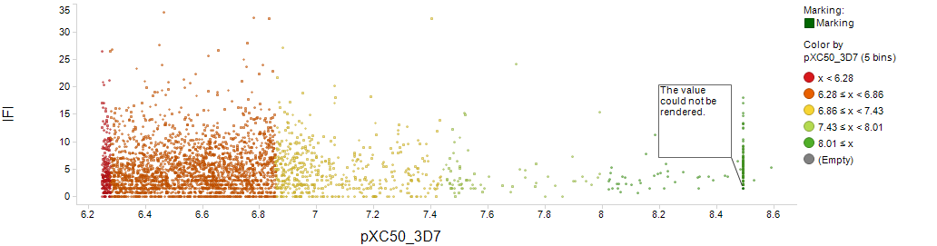
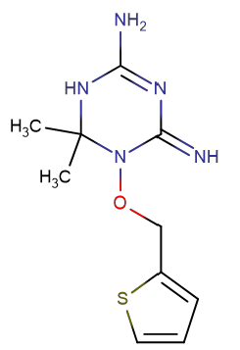
Fig4a
IFI

Slide 6
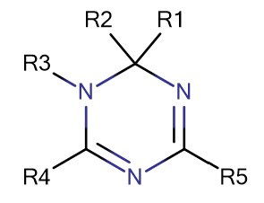
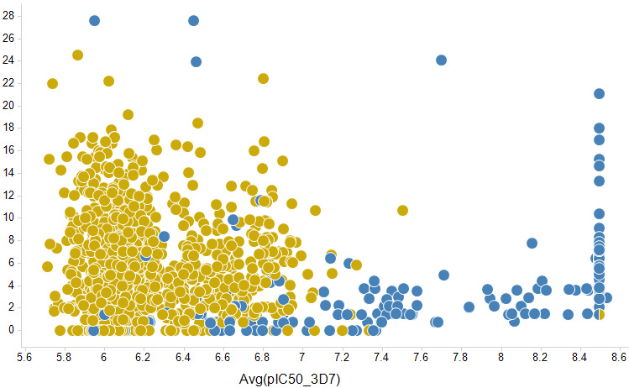
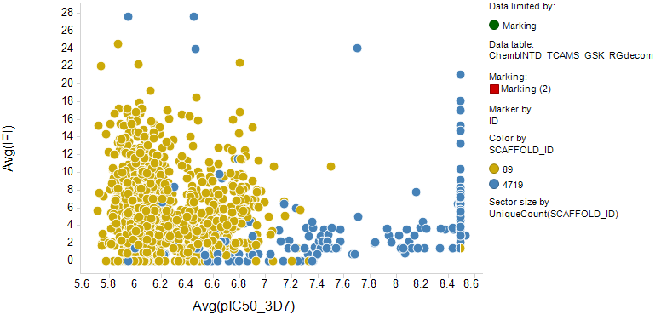
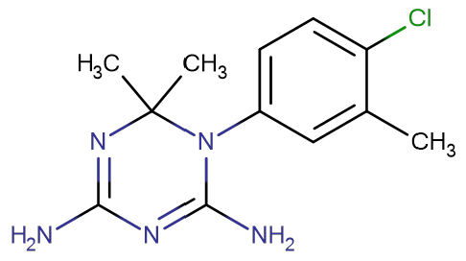
Fig4a bottom
SCAFFOLD_ID: 4719
ID: 537543
Avg(IFI)

Slide 7
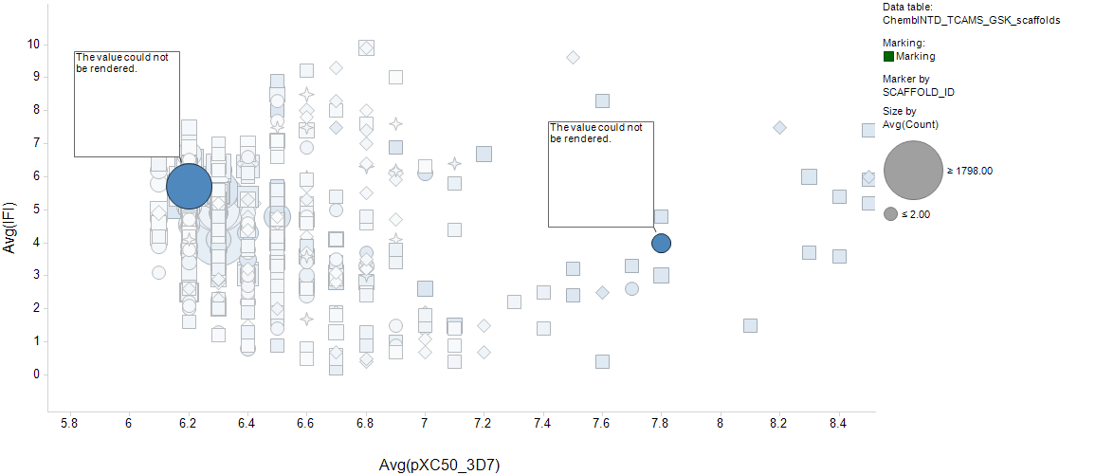
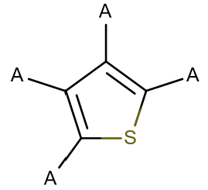
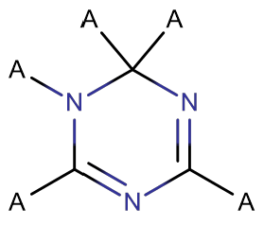
Fig 4b

Slide 8
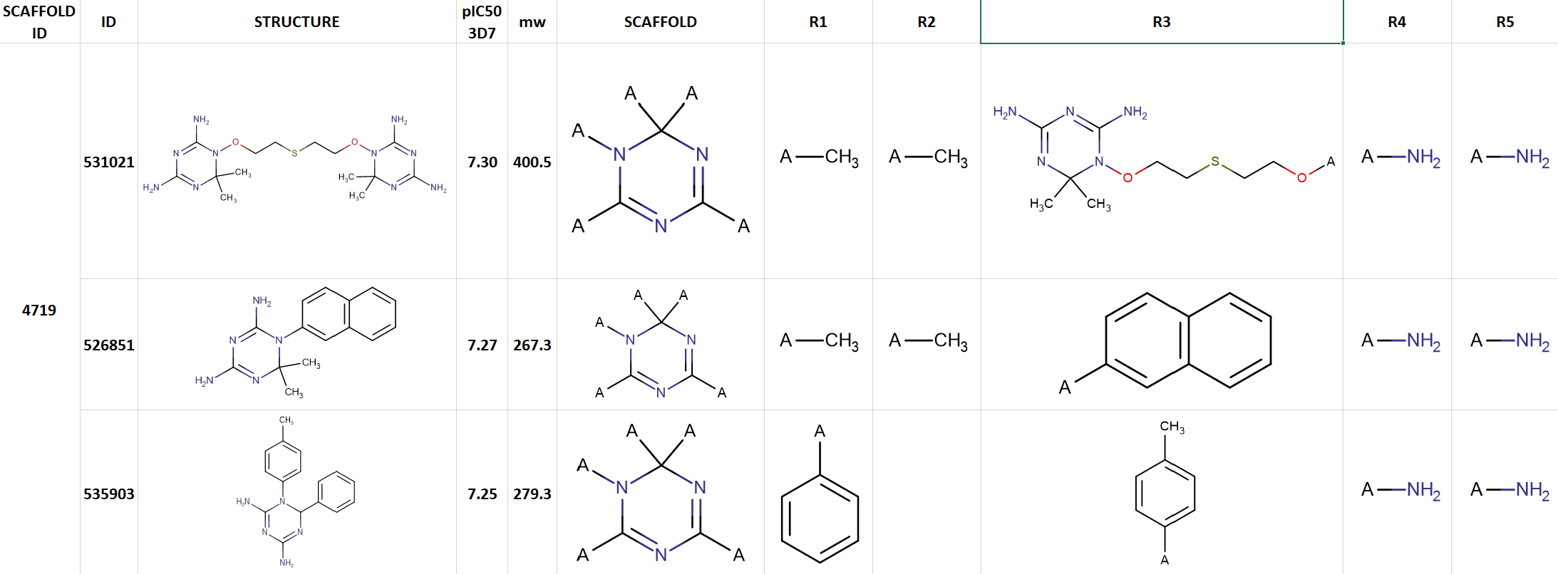
Fig4c

Slide 9
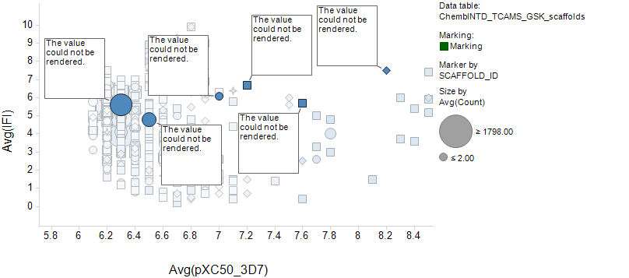
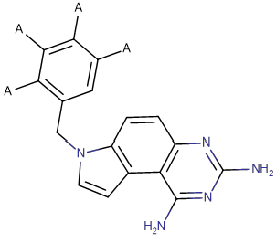
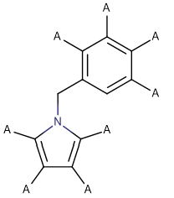
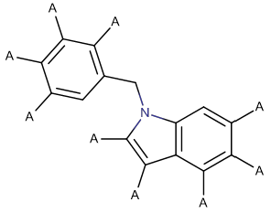
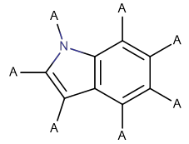
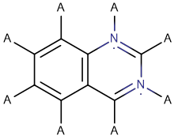
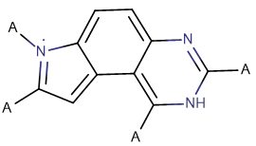
Fig 5b
3
4
1
2
6
5

Slide 10
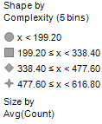
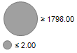
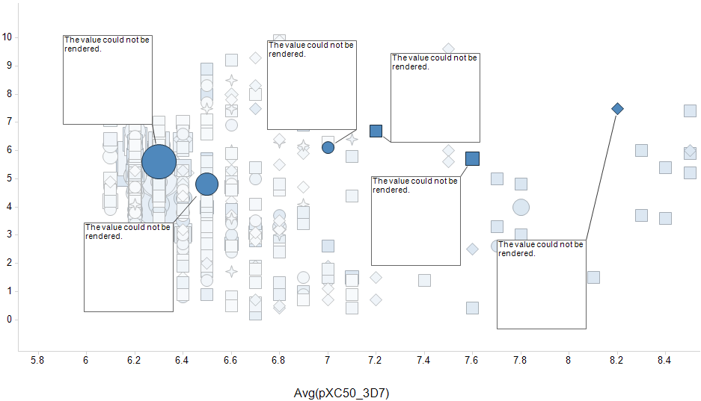

Fig 5b
Marker by SCAFFOLD_ID
Shape by Complexity
Size by Count
(# molecules that share a scaffold)
17 molecules
1016 molecules
Avg(IFI)

Slide 11
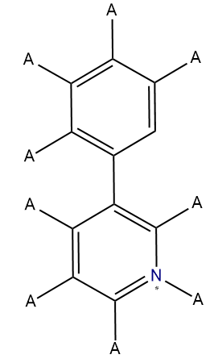
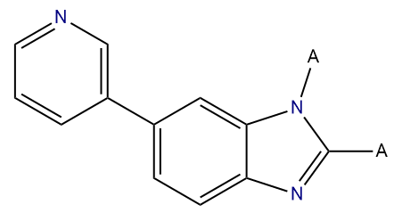
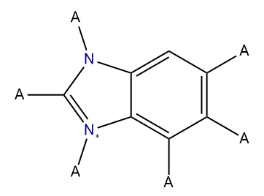
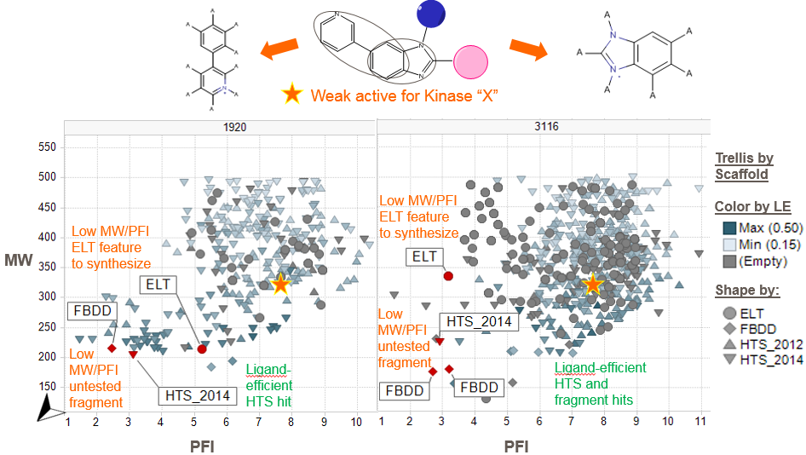
Fig 7

Slide 12
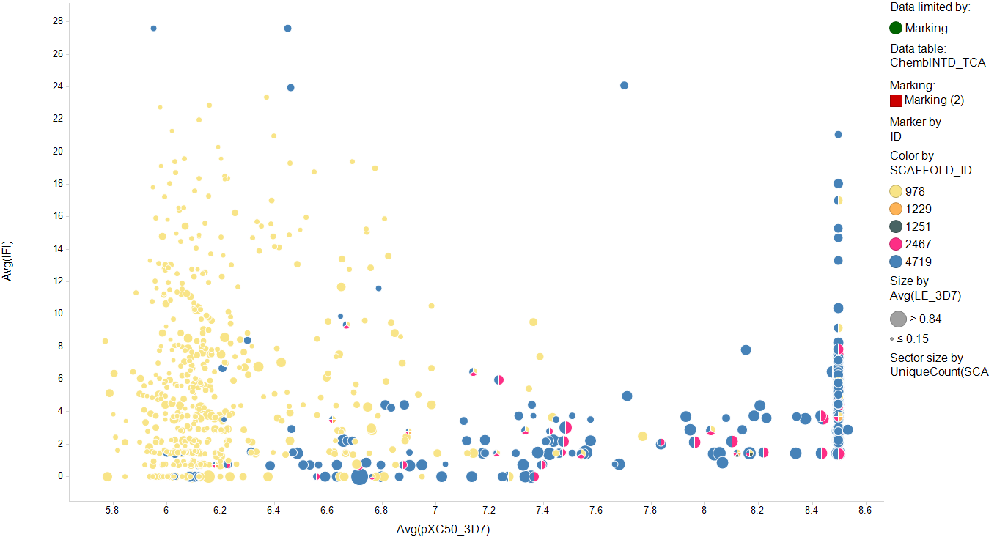
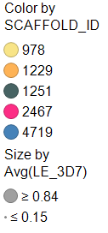
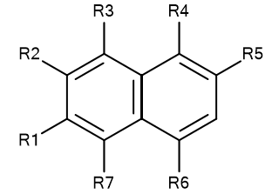
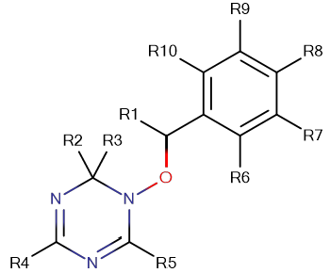
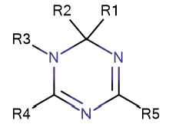
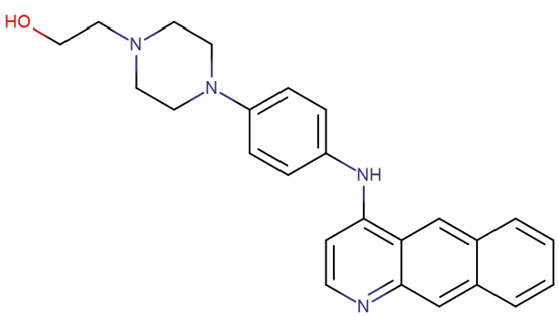
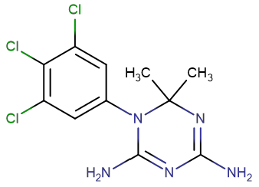
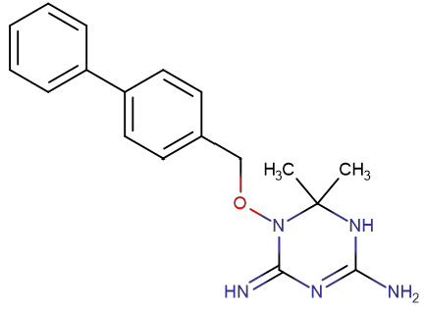
Fig8
Each pie is one compound
Each sector/color is one scaffold
Scaffold 978 alone
not highly active
Co-occurring
active scaffolds
Scaffold 4719
active by itself
SCAFFOLD_ID: 978
Avg(IFI)
SCAFFOLD_ID: 2467
SCAFFOLD_ID: 4719
4
ID: 529200
ID: 540655
ID: 525631
Notes:
Backup?

Slide 13
Fig8
Each pie is one compound
Each sector/color is one scaffold
1
Avg(IFI)
a
c
b
1
Notes:
Backup?

Slide 14
a
Scaffold 978 alone
not highly active
b
Scaffold 4719
active by itself
c
Co-occurring
active scaffolds
SCAFFOLD_ID: 978
SCAFFOLD_ID: 4719
SCAFFOLD_ID: 2467
ID: 529200
ID: 525631
ID: 540655

Slide 15
Fig8
0
1
3
5
2
4
6

Slide 16
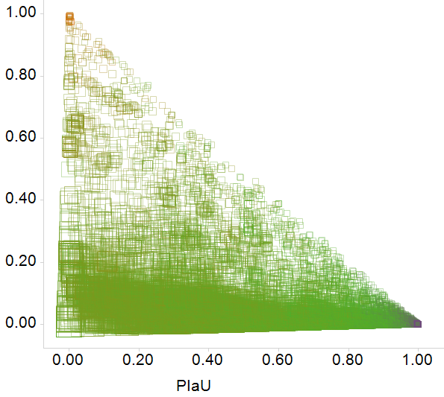
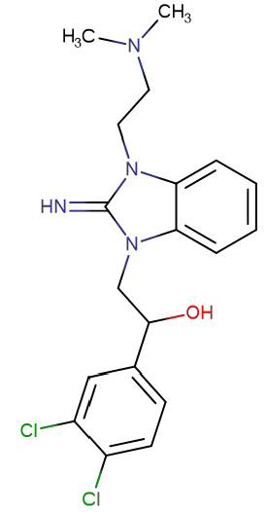
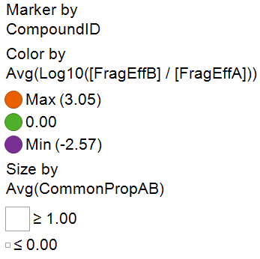
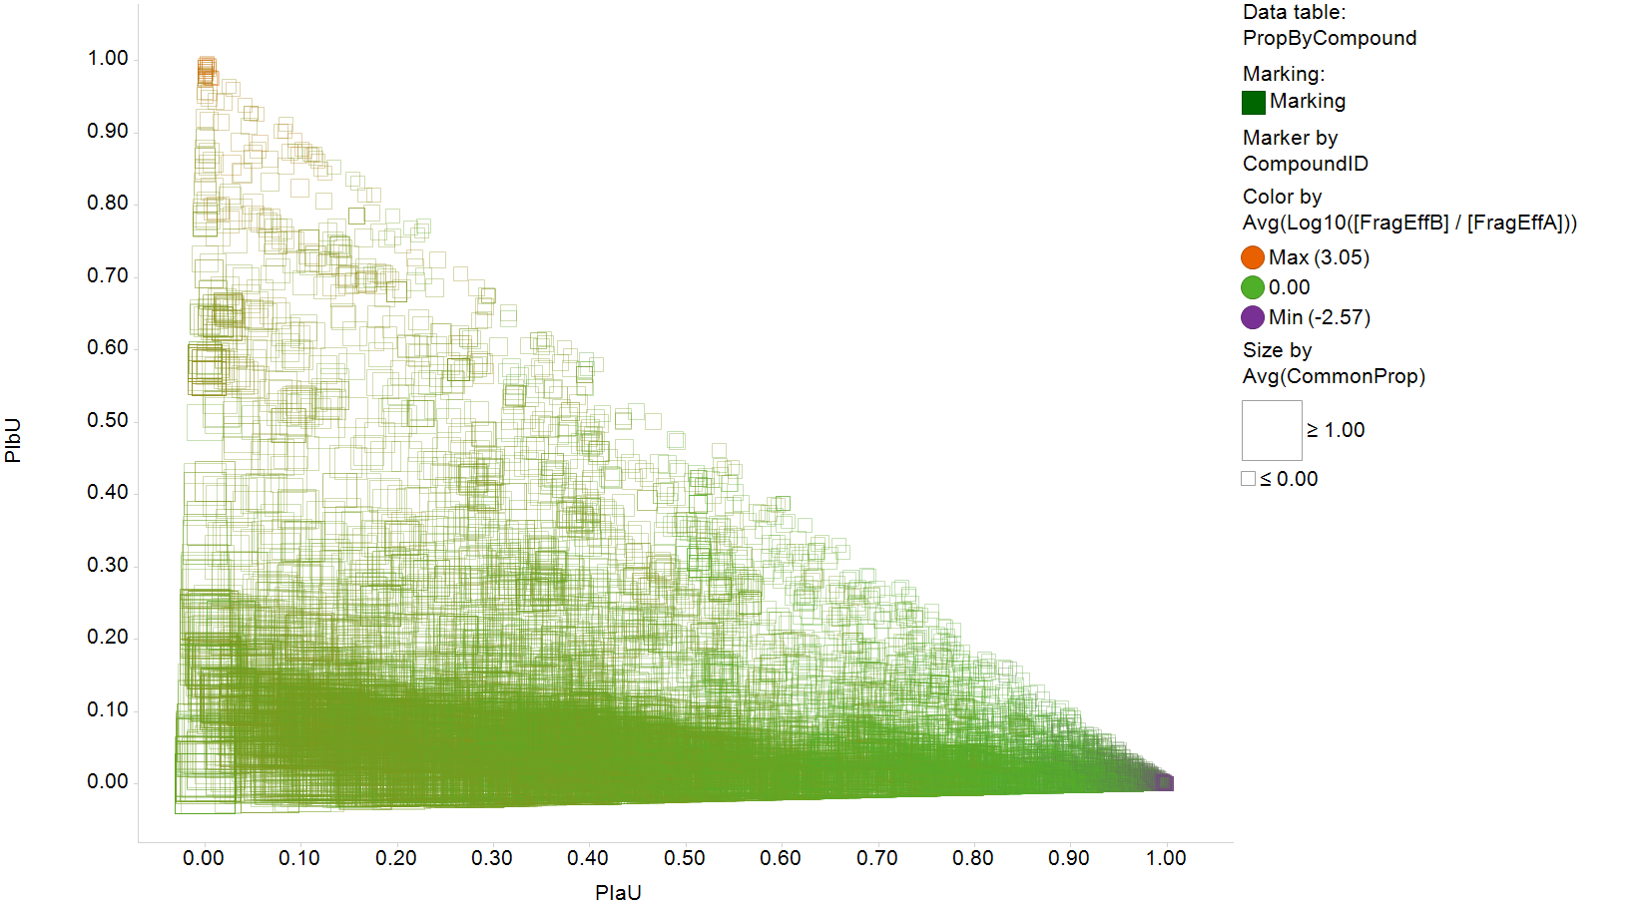
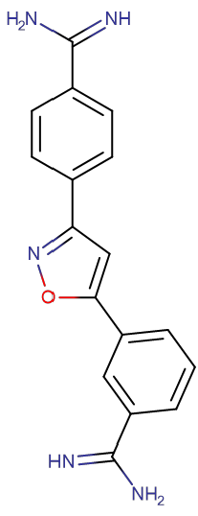
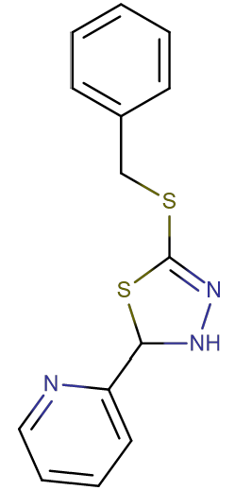
Fig 10a
Notes:
Stats:
The two methods allow you to access different sets of molecules starting from any molecule in TCAMS (average overlap in coverage is 40%).
On the aggregate (average/median), you can link to about twice as many molecules with the frameworks, however, this is because on the aggregate there are 6 times more frameworks than NCATS scaffolds, so the “fragment efficiency” is actually 3 times greater for NCATS scaffolds. One could also argue that many of the framework-only links (eg. variously decorated benzene rings) are not useful.
The outliers are interesting: compounds in a rare tautomer are unified with the dominant one by the NCATS tool, but left as singletons by the frameworks. And compounds whose only link with other molecules would be eg. a benzene ring remain singletons with the R-group tool.

Slide 17
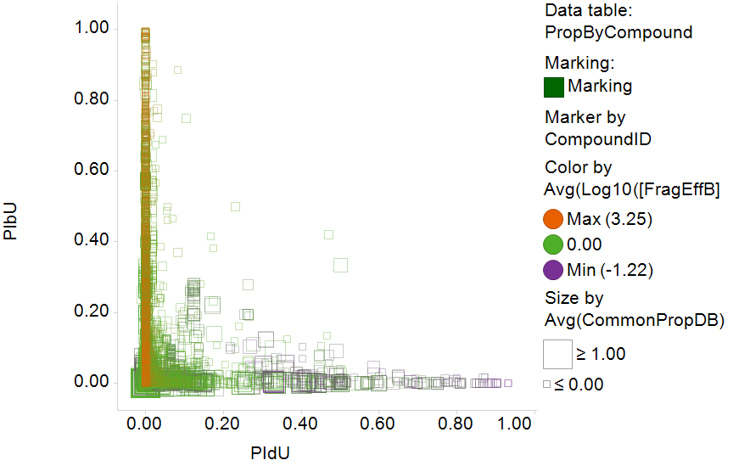
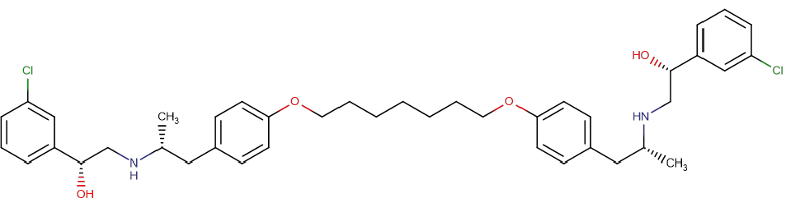
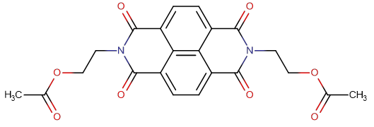
Fig 10b

Slide 18
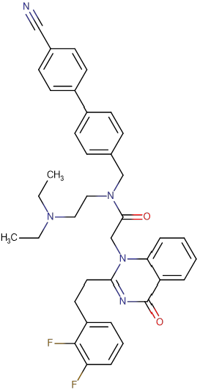
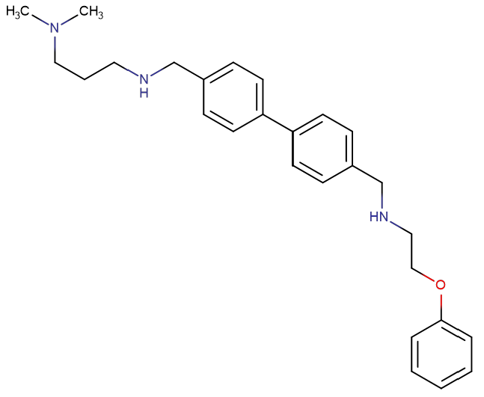
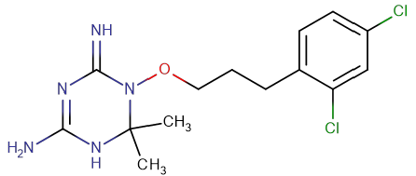
Fig11
c
d
e

Slide 19

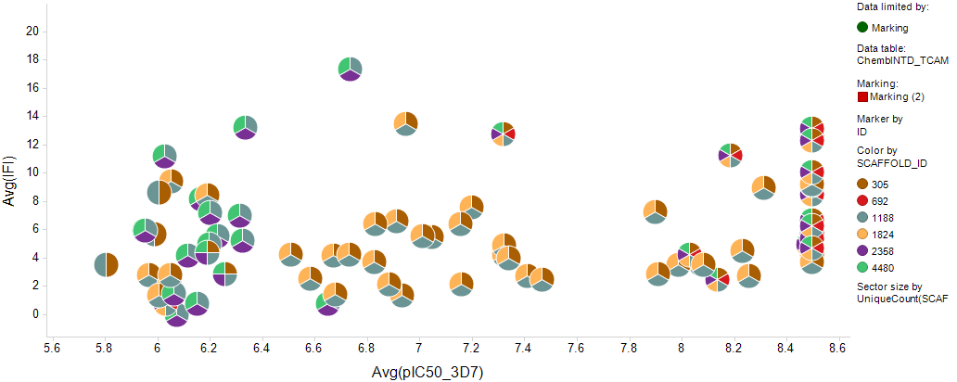
SI S9: structure group stats

Slide 20
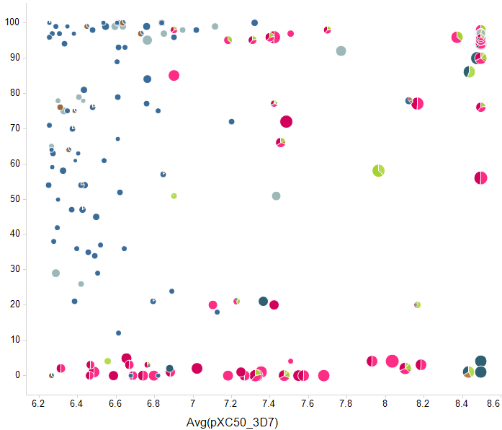


S8 qualitative comparison
Framework not active in 3D7 strain; not found by R-group tool
Avg(% inhibition in DD2/resistant strain)

Slide 21
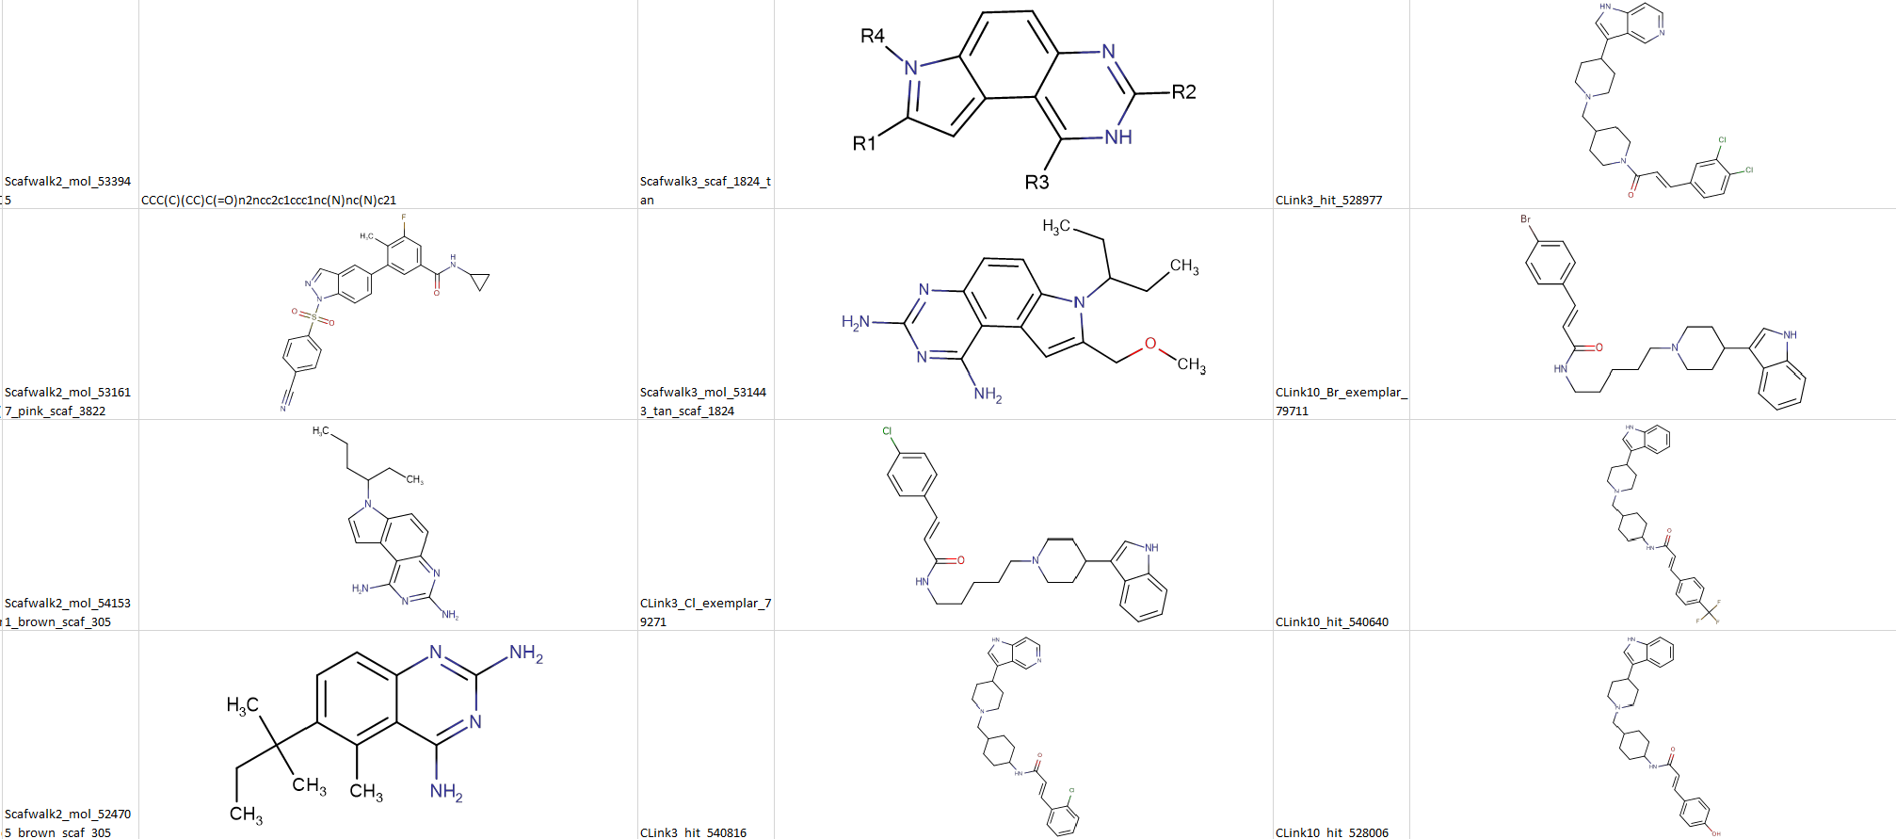

Slide 22





S1 cluster lanes
…
Cluster 3
similar molecules ≠ same cluster
Cluster 10
…

Slide 23




NCATS R-Group Tool Example: Deconstruct SAR of Related Molecules
Scaffold
Hopping
?
Each pie is one compound
Each sector/color is one scaffold
3
Size by
Ligand Efficiency (3D7)
IFI
a
c b
pIC50 in 3D7 (PF susceptible strain)

Slide 24



a
Indazoles alone
only weakly active
b
Quinazolines alone
active, ligand efficient
c
Discover alternate tricycles;
fuse design ideas
SCAFFOLD_ID: 305
ID: 524705
SCAFFOLD_ID: 305
ID: 541531
SCAFFOLD_ID: 1824
ID: 531443

Slide 25



NCATS R-Group Tool Example: Iterative SAR Exploration
Scaffold
Hopping
?
Each pie is one compound
Each sector/color is one scaffold
4
IFI
a
pIC50 in 3D7 (PF susceptible strain)
Size by Ligand Efficiency (3D7)
Notes:
10 sec. short script

Slide 26

a
New tricycle scaffold (1824) seems more active than indoles or quinazolines alone
SCAFFOLD_ID: 1824
ID: 531443

